Slide 1
Custom Sorting implementation

Slide 2
Introduction: | Overview - sorting Algorithm , implementation in software development on real time basis Purpose: to implement the algorithms effectively in the java program which helps in sorting the given data in ordered form which saves time.
Background: | Information of the project : algorithms, data structures , code simplification Framework : spring boot Key elements used in the project : arrays and conditional statements Importance of the project : Gain confidence in sorting the complex algorithms and implementation of real time solutions
Methodology: | Methods and techniques : merge and tim sort Data collection approach : user defined data for the object Tools used in this project : Maven, spring. Limitations : limited data base usage
Results: | Out come of the project : simplification of the complex data structures. unexpected/exceptions : data confirmed to user defined data
Conclusion : | Contribution of the result to the project : aim of the project is to understand the shortcomings of the complex data structures , code simplification, solving real time scenarios.

Slide 3
Team members/Stakeholders
Kavya vadlamudi
Avinash reddy
Neha korukonda
Vineetha Attuluri

Slide 4

Project Overview
Custom sorting refers to the ability to define your own criteria for sorting elements in a list or array, rather relying solely on default sorting algorithms provided by programming languages with the advantages like
Flexibility, Domain-specific sorting, Performance optimization, Complex sorting criteria, Maintaining stability, Sorting non-comparable objects, Customization for user preferences

Slide 5

Technologies & Tools Java Spring boot Junit

Slide 6
Algorithms implemented
Heapsort
Insertion sort
Merge sort

Slide 7
Heapsort Implementaion

Slide 8
Merge sort

Slide 9
Insertion

Slide 10
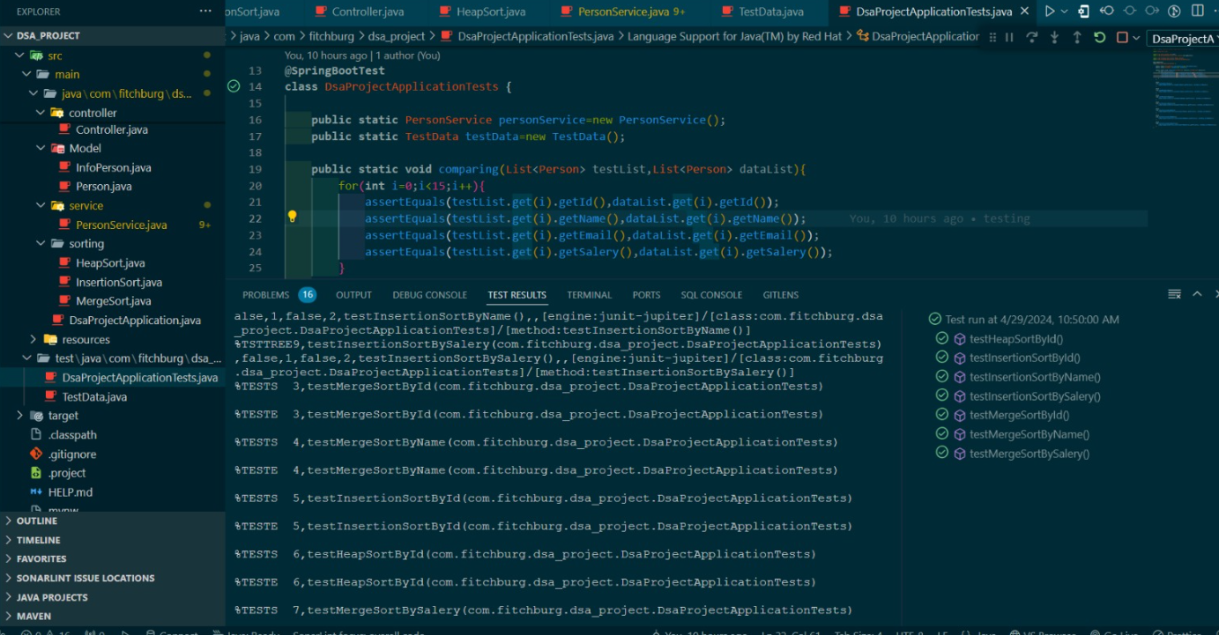

Slide 11
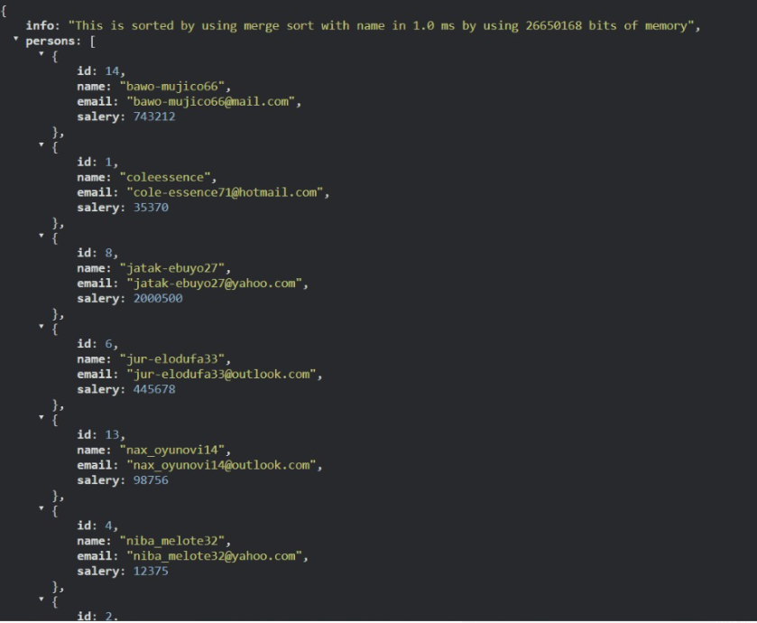

Slide 12
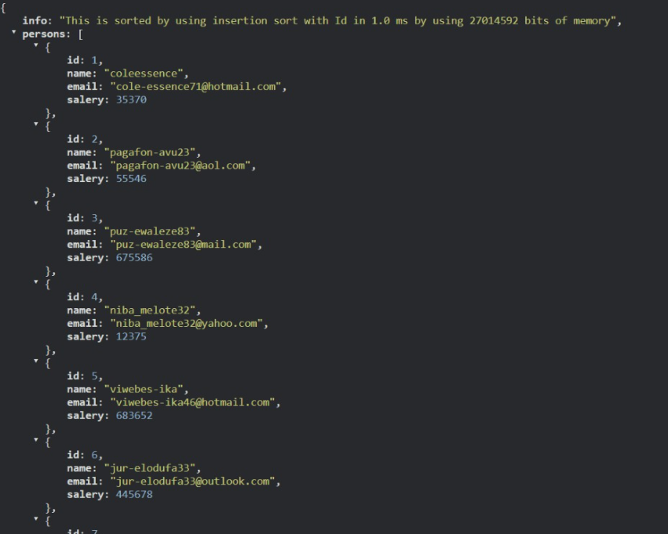

Slide 13
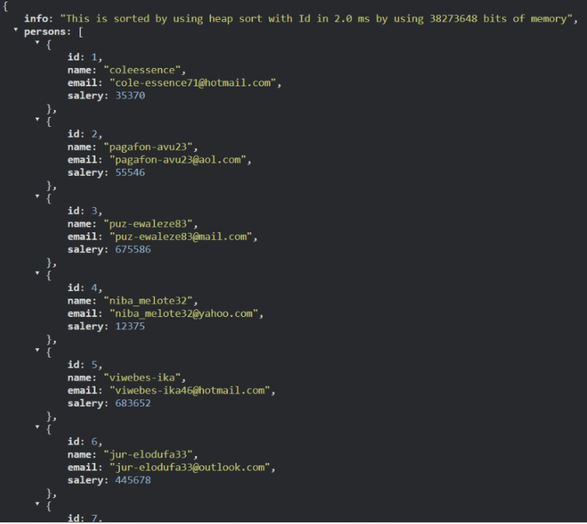

Slide 14
Git Hub links
Repository
https://github.com/DaaProject04/DSA_Project
Presentation
https://github.com/DaaProject04/DSA_Project/blob/main/Sorting%20Techniques%20PPT.pptx

Slide 15


